Slide 1




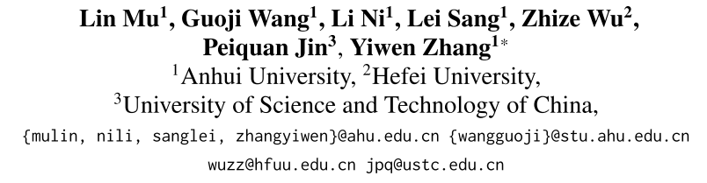



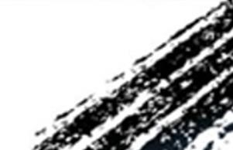

ATAI
Advanced Technique of Artificial Intelligence
ATAI
ChongqingUniversity _{AdvancedTechniqueof}
of Technology Artificial Intelligence
Chongqing University of
Technology
Chongqing University ^{ATAI}
_{of Technology} Advanced Techniqueof
Artificial Intelligence
Chongqing University of Technology
Chongqing University of Technology
GraphLoRA: Structure-Aware Low-Rank Adaptation for LargeLanguage
Model Recommendation
Code:https://github.com/wgj15965/GraphLoRA.
—— ACL_2026
Reported by Long Zhang
1

Slide 2
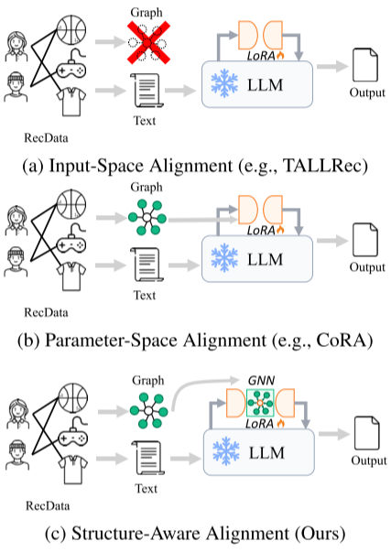
ATAI
Advanced Technique of Artificial Intelligence
ATAI
ChongqingUniversity _{AdvancedTechniqueof}
of Technology Artificial Intelligence
Chongqing University of
Technology
Chongqing University ^{ATAI}
_{of Technology} Advanced Techniqueof
Artificial Intelligence
Chongqing University of Technology
Chongqing University of Technology
Motivation
Existing methods either translate collaborative information into textual prompts or inject pre-trained embeddings into the LLM, both of which treat structural information as static input and fail to capture high-order relational dependencies.
a) Input-Space Alignment: Only the structural information is passively read, and the relationship dependence cannot be reasoned internally.
b) Parameter-Space Alignment: It is impossible to perform end-to-end joint optimization with the semantic representation of LLM, and it is also difficult to dynamically capture the relationship dependence of high-order neighborhoods.

Slide 3
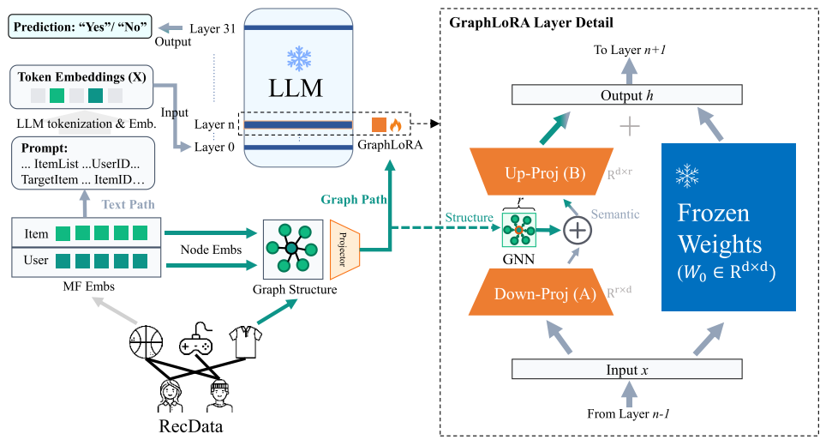
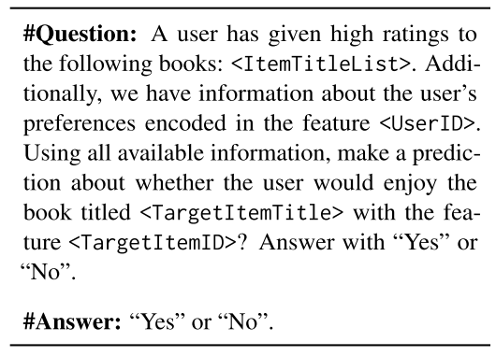
ATAI
Advanced Technique of Artificial Intelligence
ATAI
ChongqingUniversity _{AdvancedTechniqueof}
of Technology Artificial Intelligence
Chongqing University of
Technology
Chongqing University ^{ATAI}
_{of Technology} Advanced Techniqueof
Artificial Intelligence
Chongqing University of Technology
Chongqing University of Technology
Method

Slide 4







ATAI
Advanced Technique of Artificial Intelligence
ATAI
ChongqingUniversity _{AdvancedTechniqueof}
of Technology Artificial Intelligence
Chongqing University of
Technology
Chongqing University ^{ATAI}
_{of Technology} Advanced Techniqueof
Artificial Intelligence
Chongqing University of Technology
Chongqing University of Technology
Method

Slide 5
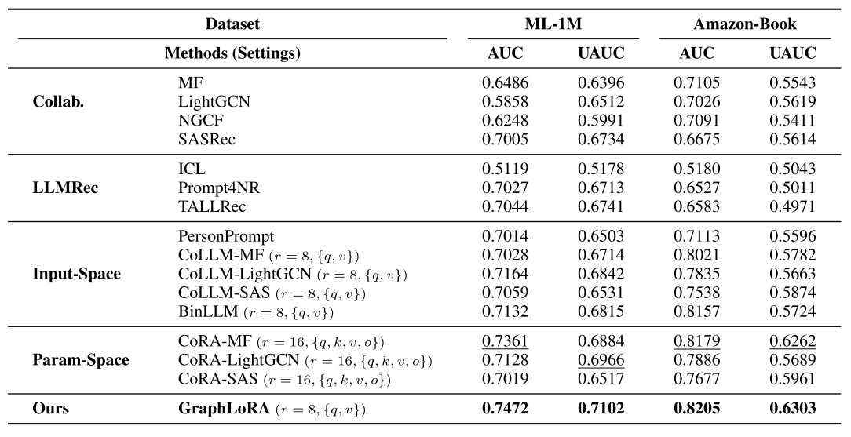
ATAI
Advanced Technique of Artificial Intelligence
ATAI
ChongqingUniversity _{AdvancedTechniqueof}
of Technology Artificial Intelligence
Chongqing University of
Technology
Chongqing University ^{ATAI}
_{of Technology} Advanced Techniqueof
Artificial Intelligence
Chongqing University of Technology
Chongqing University of Technology
Experiments

Slide 6
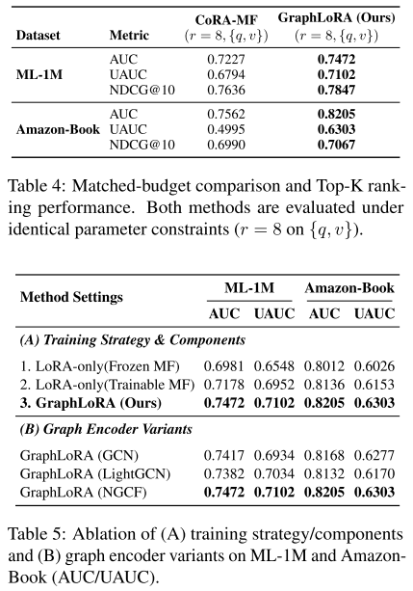
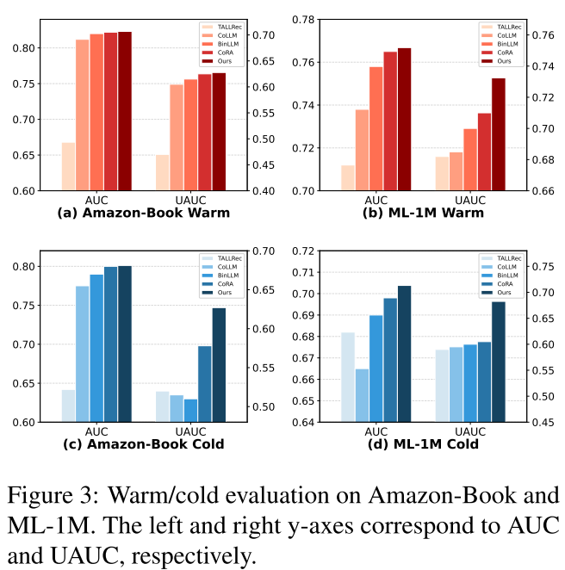
ATAI
Advanced Technique of Artificial Intelligence
ATAI
ChongqingUniversity _{AdvancedTechniqueof}
of Technology Artificial Intelligence
Chongqing University of
Technology
Chongqing University ^{ATAI}
_{of Technology} Advanced Techniqueof
Artificial Intelligence
Chongqing University of Technology
Chongqing University of Technology
Experiments

Slide 7
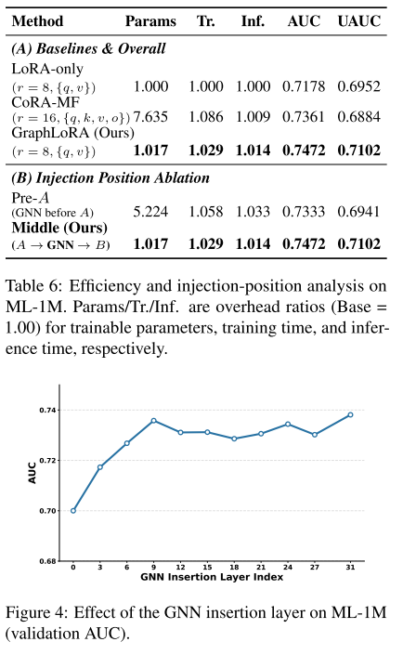
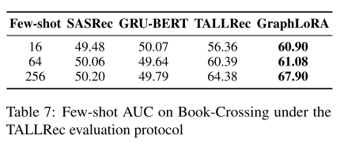
ATAI
Advanced Technique of Artificial Intelligence
ATAI
ChongqingUniversity _{AdvancedTechniqueof}
of Technology Artificial Intelligence
Chongqing University of
Technology
Chongqing University ^{ATAI}
_{of Technology} Advanced Techniqueof
Artificial Intelligence
Chongqing University of Technology
Chongqing University of Technology
Experiments
Vicuna 7B --> LLaMA 7B

Slide 8


ATAI
Advanced Technique of Artificial Intelligence
ATAI
ChongqingUniversity _{AdvancedTechniqueof}
of Technology Artificial Intelligence
Chongqing University of
Technology
Chongqing University ^{ATAI}
_{of Technology} Advanced Techniqueof
Artificial Intelligence
Chongqing University of Technology
Chongqing University of Technology
Thanks!

